Slide 1

بِسْمِ اللّهِ الرَّحْمَنِ الرَّحِيْمِ

Slide 2

GROUP INTRO
Mushtaque Ali
Amara
Daniyal
M. Mureed
Saqib Shah

Slide 3

Title:
The Economic System in Islam

Slide 4

Introduction To Economics

Slide 5
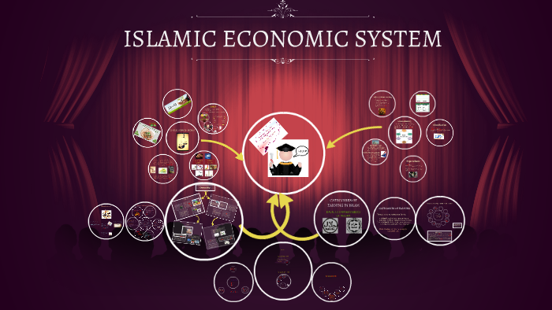

Slide 6

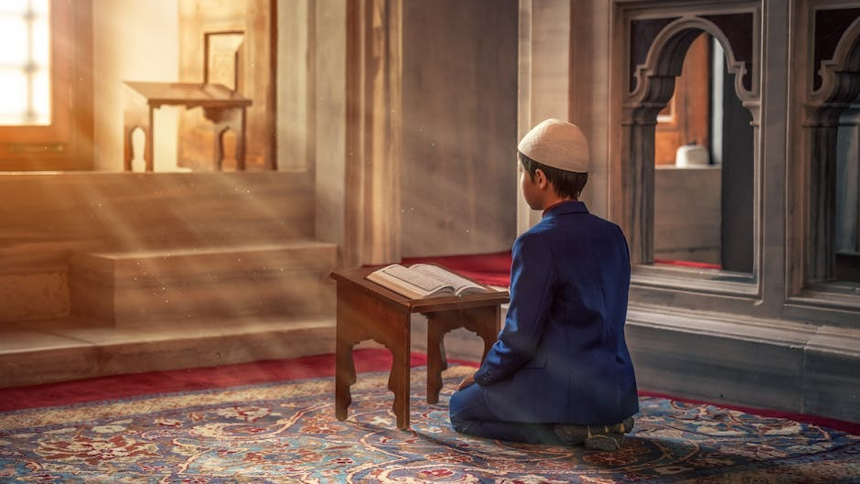
QURANIC TEACHINGS REGARDING ISLAMIC ECONOMICS

Slide 7
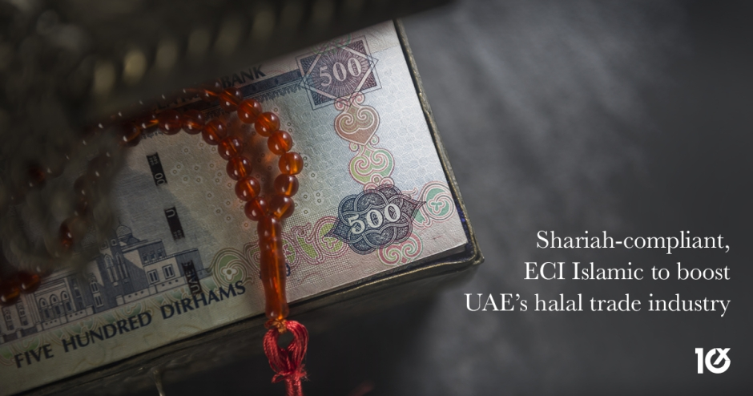

Sharia And Economic Transactions

Slide 8
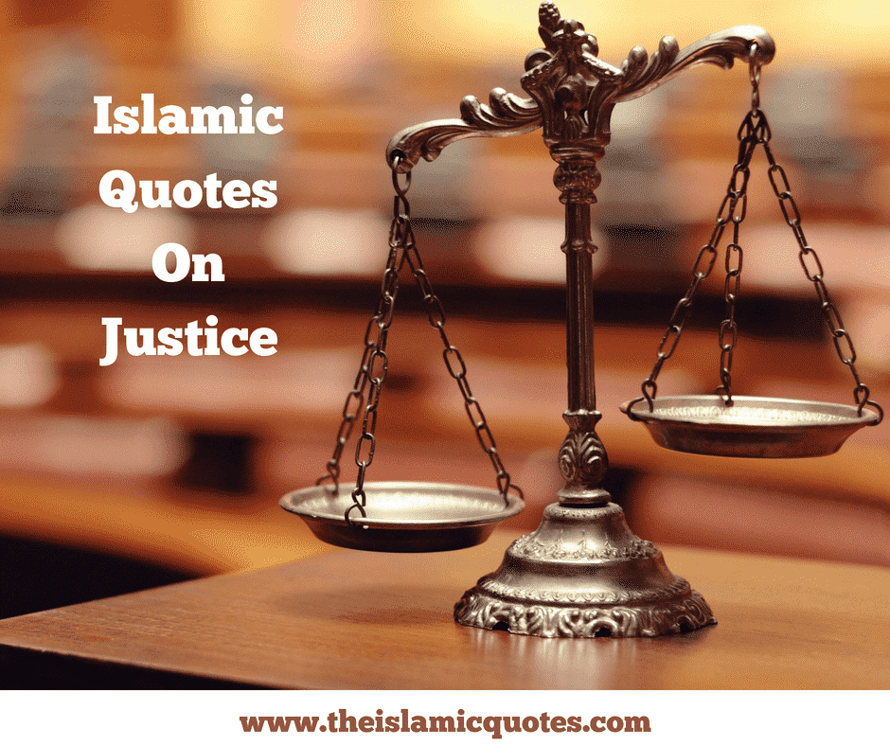

Social Justice In Islam

Slide 9


Women’s economics Endowment in Islam

Slide 10

Work And Employment Ethics

Slide 11

Property Rights and Economic Justice

Slide 12

Economic Stability and Sustainability

Slide 13

Contemporary Applications

Slide 14
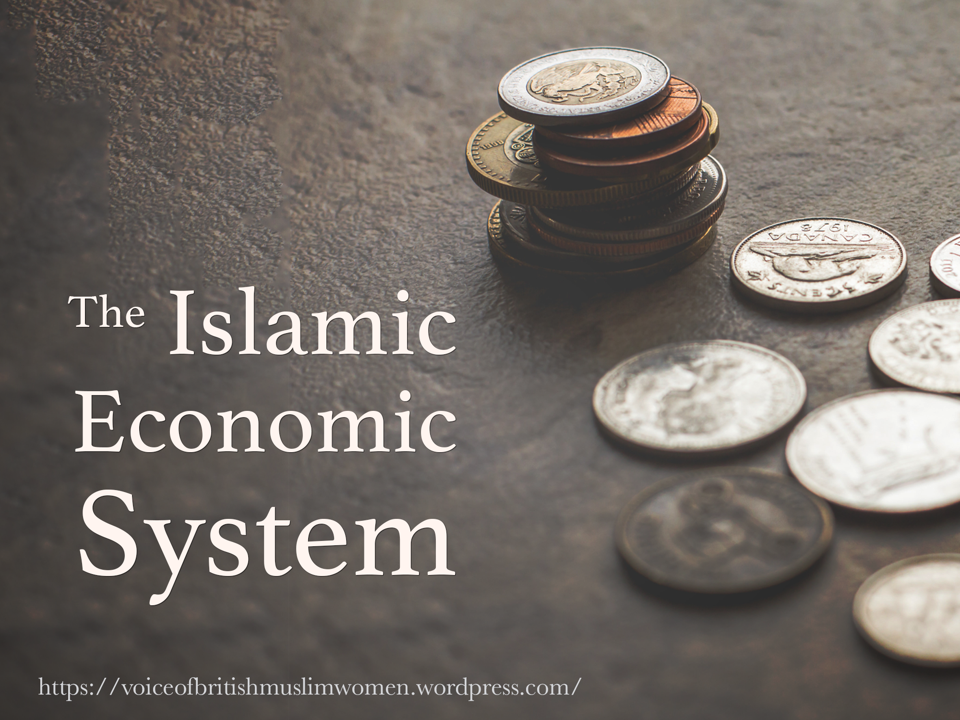
Conclusion

Slide 15


